Slide 1

Dynatrace on Azure
Modernize and Monitor Applications with Dynatrace on Azure

Slide 2
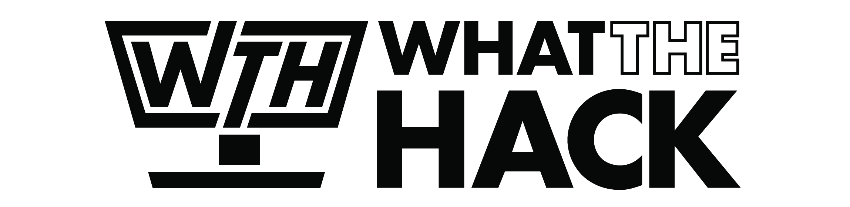
Dynatrace on Azure
Welcome & Intros
<Coach Name>
<Coach Name>
<Coach Title>
<Coach Title>
<Coach Name>
<Coach Name>
<Coach Title>
<Coach Title>
Notes:
Coaches/Presenters for THIS hack/lecture event should be listed on this slide.
Original contributors to the hack content & these slides include:
Please list original contributors to this hack here in the speaker notes and give them credit when delivering this content.
<Original Author 1>
<Original Author 2>
…
<Original Author N>

Slide 3
Workshop Objectives
​
Common challenges associated with modernization​
How to solve challenges of hybrid cloud with Dynatrace observability​
Improve acceleration of cloud workload adoption of Azure

Slide 4
Dynatrace & Microsoft

Slide 5
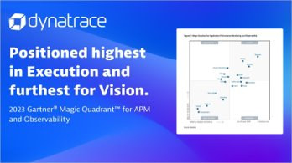
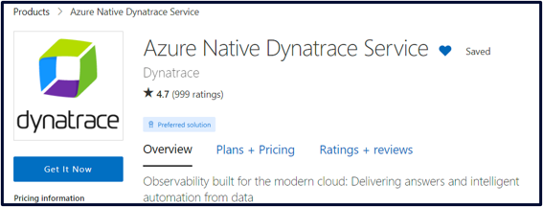





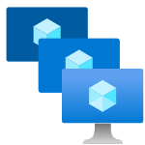
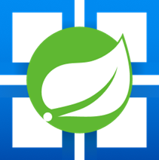



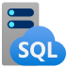
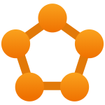

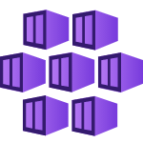




Strong Collaboration with Microsoft
Leading intelligent observability platform
Top Microsoft Marketplace Partner
Deep technical integration – availability of Azure Native Dynatrace Service
MACC eligible
Well Architected & Cloud Adoption Framework
Dynatrace real-time observability into dynamic Azure environments​
Ever growing support for Azure services
Azure AI Search
Azure OpenAI
Azure Batch
Azure Blob Storage
Azure Functions
Azure VM Scale Sets
Azure Spring Cloud
Azure Cosmos DB
Azure DB for PostgreSQL
Azure SQL
Azure Managed SQL
Azure Service Fabric
Azure App Service
Azure Kubernetes Service
Azure Load Balancer
Azure ML
Azure Data Lake
Azure Application Gateway
…and many more!

Slide 6


Out of the box support for Azure cloud native architectures
Ever growing support for Azure services
Real-time observability into dynamic environments​
With automatic instrumentation for dynamic microservices and unique hybrid support, Dynatrace monitors your entire cloud including all dependencies in real time with no blind-spots. Dynatrace OneAgent supports byte-code instrumentation for Azure App Service, Web Apps, Azure VMs, Azure Functions, Azure Spring Cloud, Azure Kubernetes Service, Azure VM Scale Sets.
Azure Cognitive Services
Azure Application Gateway
Azure Batch
Azure Blob Storage
Azure Cosmos DB
Azure DB for Maria DB
Azure SQL
Azure Managed SQL
Azure Functions
Azure VM Scale Sets
Azure Spring Cloud
…and many more!
Azure Load Balancer
Azure Machine Learning
Azure Data Lake
Azure Service Fabric
Azure App Service
Azure Kubernetes Service

Slide 7
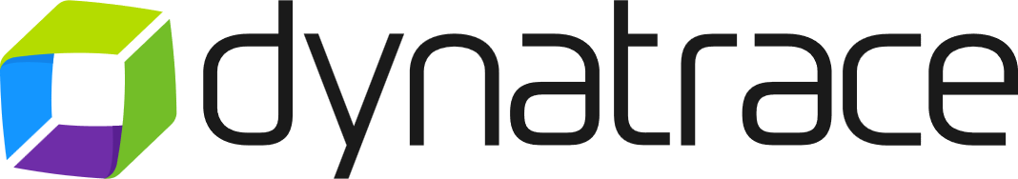
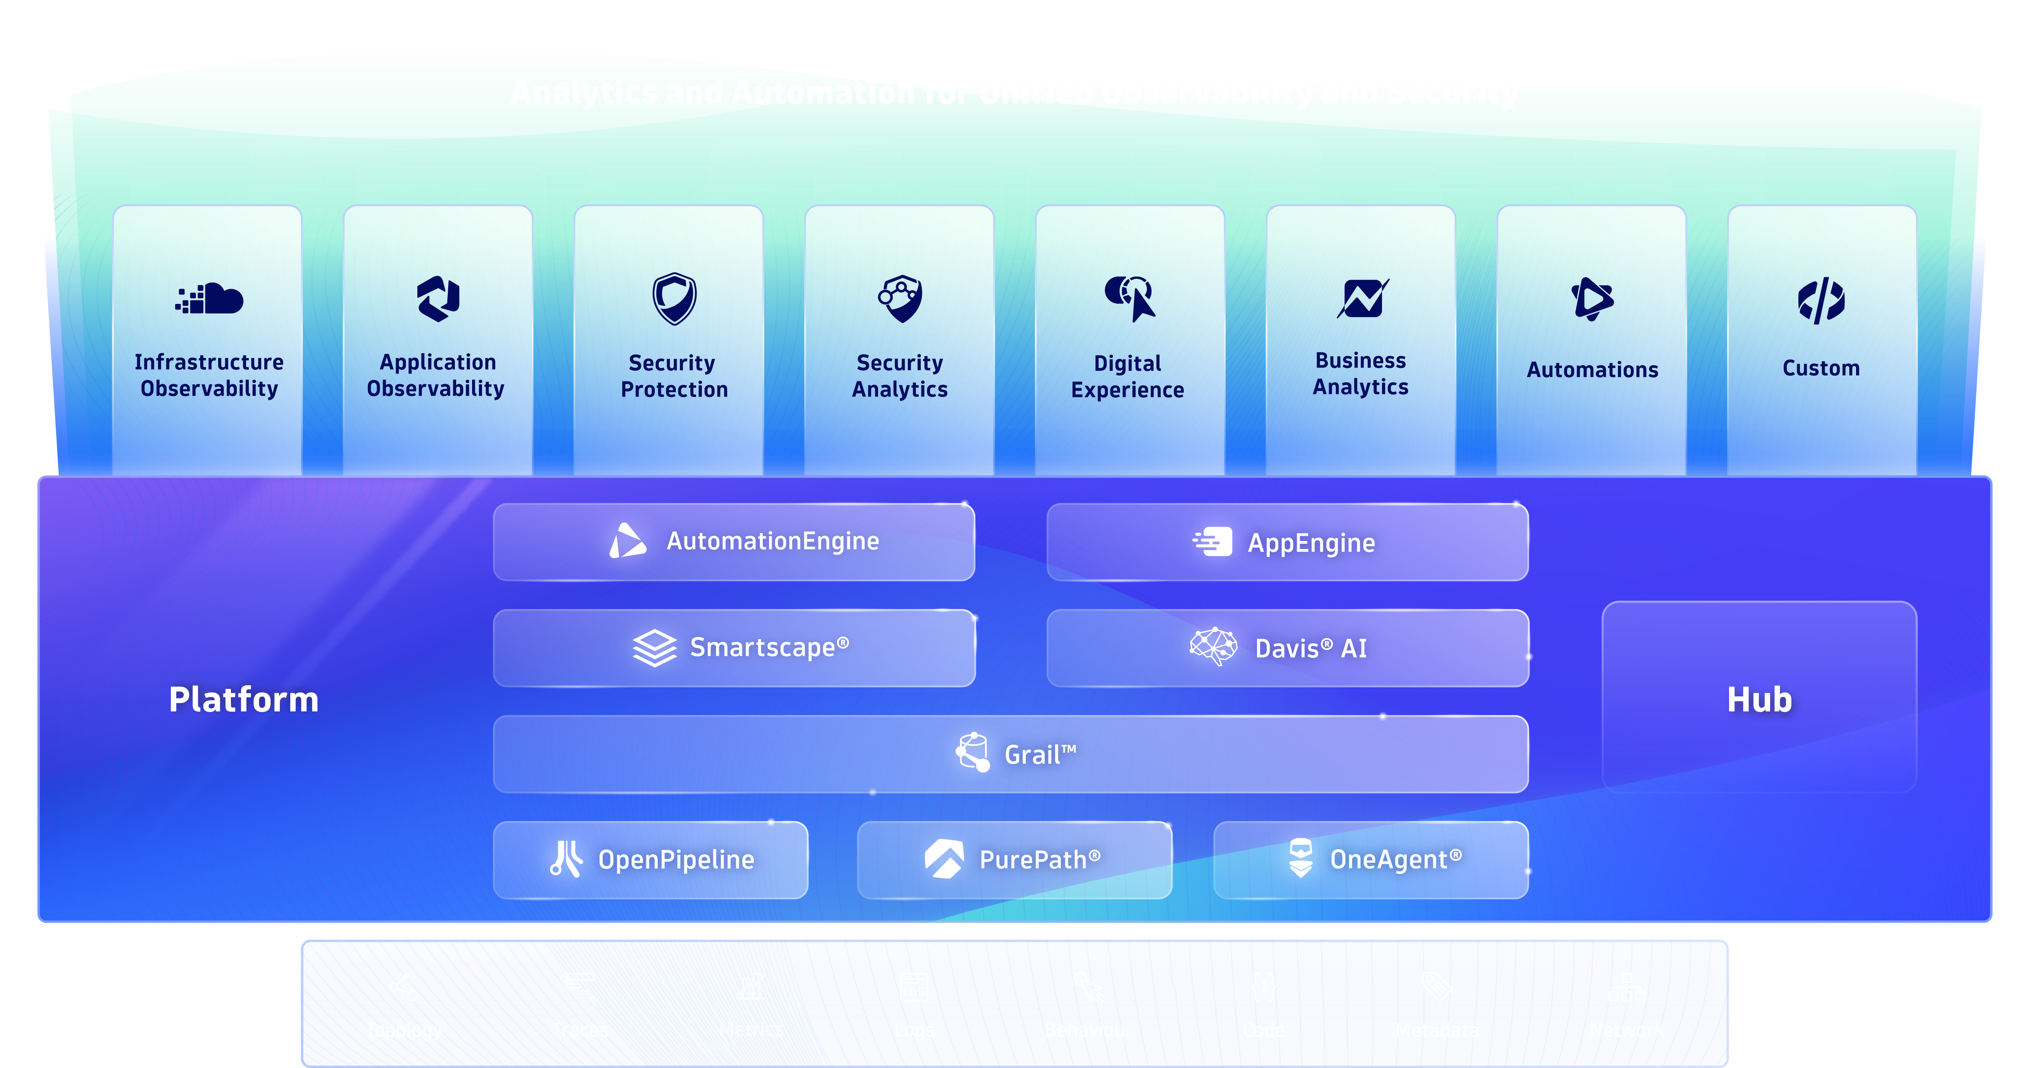





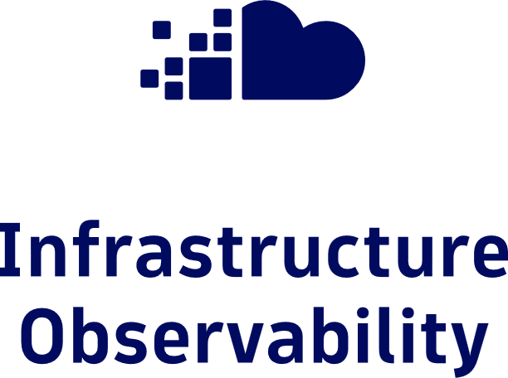
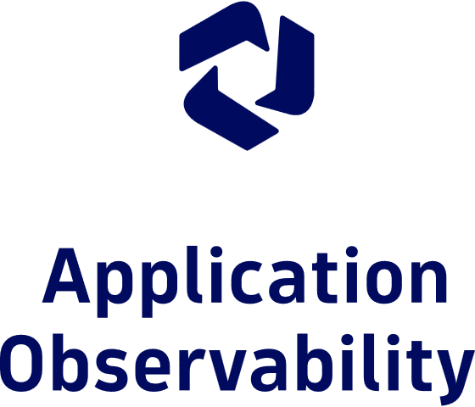


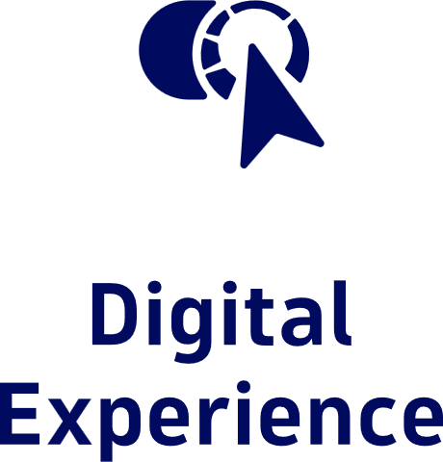

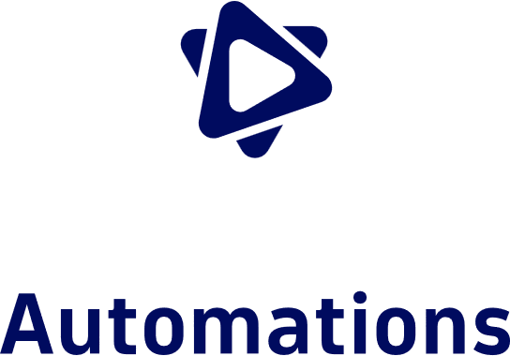
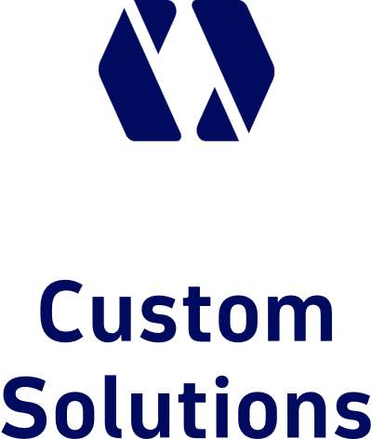

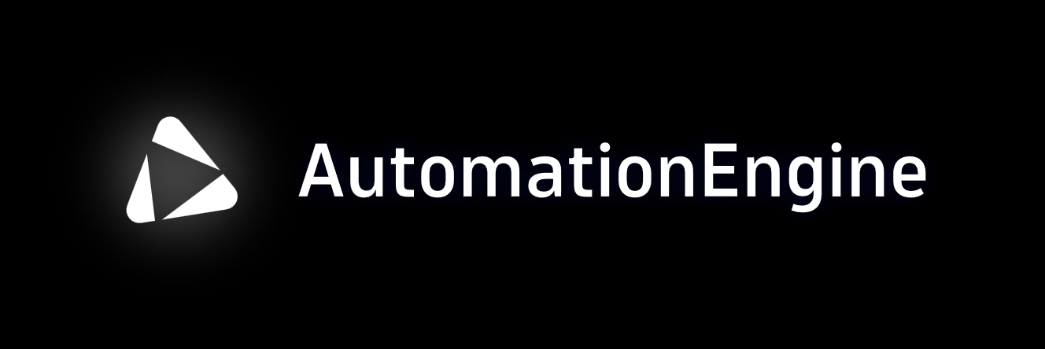
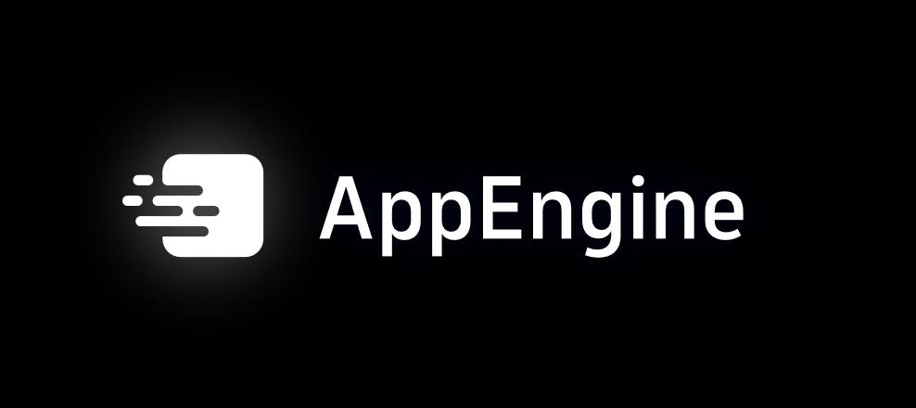



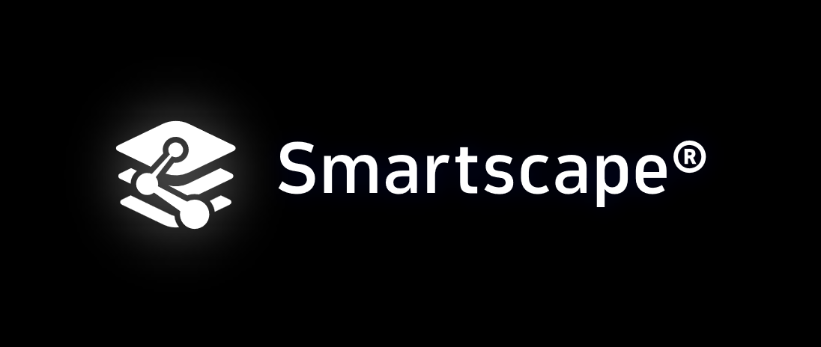
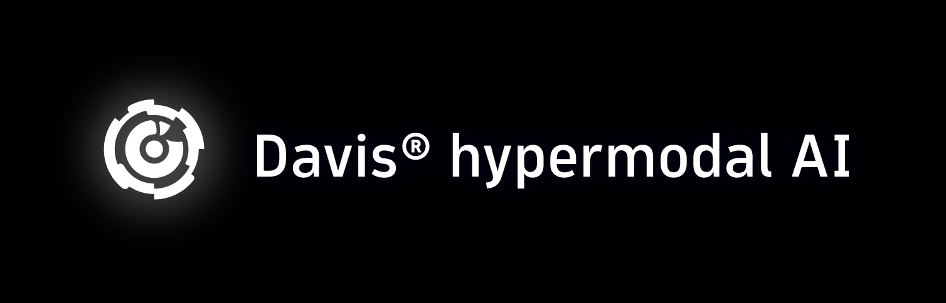




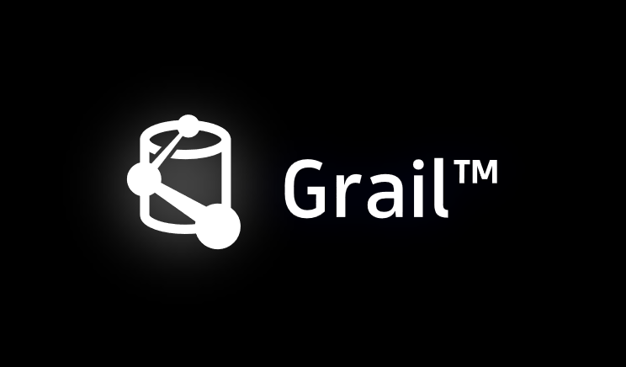
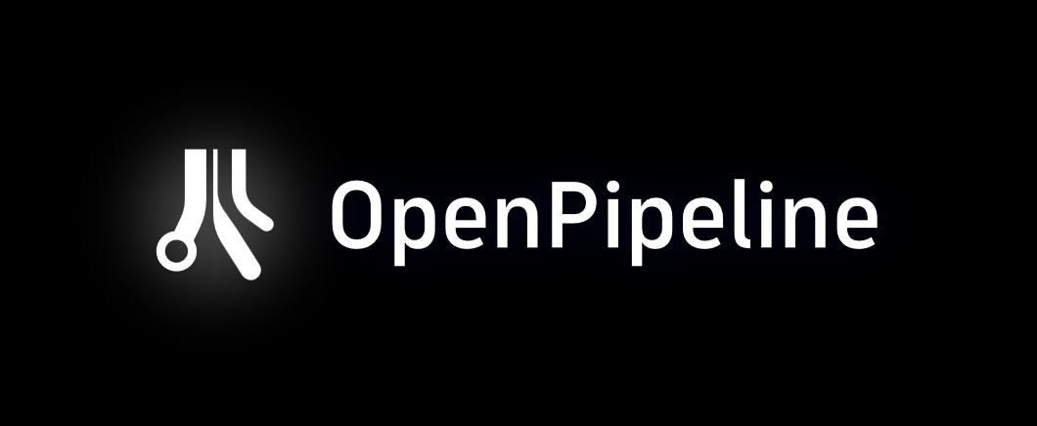
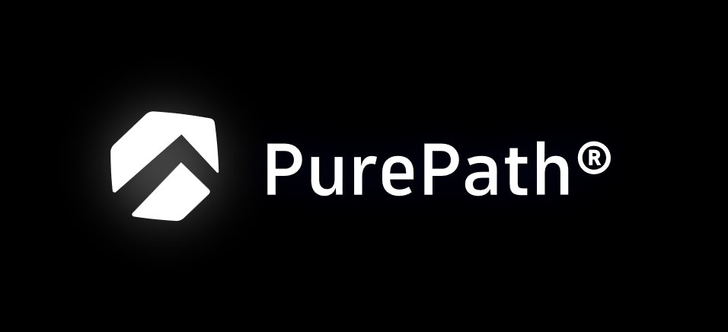






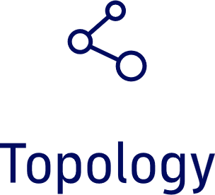
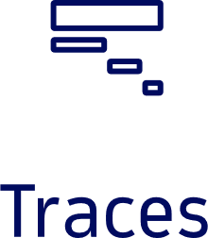
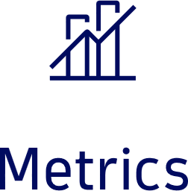
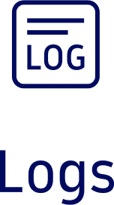
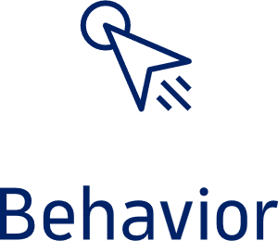
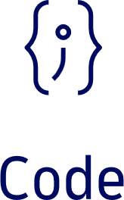
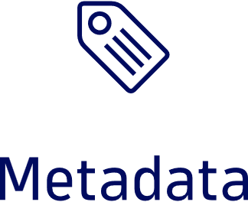
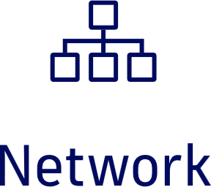
Analytics and Automation for Unified Observability and Security
Notes:
For those that aren’t as familiar, this is the Dynatrace platform. Simply put: it turns your data – in any form, from anywhere – into a goldmine of insights and answers.
As we touched on previously, it is not uncommon for organizations to have disparate tools and teams for monitoring applications, infrastructure, logs, cloud services, databases, and the user experience - and then after an issue, dozens of your best people spend hours or days manually correlating the different alerts and trying to understand: what happened, when, and where… who is responsible – and also determine the business impact.
The Dynatrace platform-based approach removes all that wasted time, and provides you - not with just alerts - but answers so you can resolve the issue before it impacts your users. And it’s made possible because of a set of fully-integrated technologies that work across each solution area to help you do amazing things with data… and it starts with [next slide]
**extra optional detail**
And includes an ever-expanding hub of integrations, extensions, and apps that connect across your ecosystem to solve any challenge. We make it easy to deliver precise answers that drive automation for almost any custom use case you can imagine. Through your innovative app engine and automation engine, those answers are enabled by Davis AI, the industry’s first hypermodel artificial intelligence. Davis combines predictive AI models to forecast future problems. Causal AI to determine and deliver precise and intelligent automations, and Generative AI to create recommendations that solve specific tasks. And Smartscape brings context to the entire platform through always-evolving topology and dependency mapping. This is made possible by Grail, our ground breaking data lakehouse that processes, analyzes, and retains all your data in context and at massive scale. We contextualize all that data through ingest and capture on any environment, whether its from open-source data sets, like OpenTelemetry, or with our OneAgent which captures and pre-processes data automatically. While PurePath provides insights to traces at code-level depth across services to quickly remediate issues [Dynatrace Platform]

Slide 8
Cloud Modernization Challenges

Slide 9

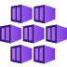





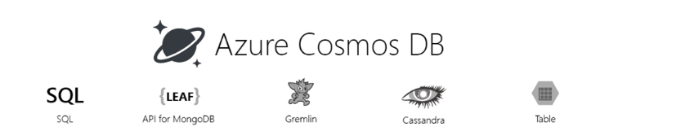
Your Modernization Journey
Move to the Cloud
Containerize Applications
Move-to-Serverless
Build with Cloud-Native
Apps / DBs run on VMs
No code changes
Develop & deploy faster
Application portability
No code changes
License freedom/savings
Performance improvement
Cross-platform support
Microservices-based
Serverless architecture
DevOps model
Applications
Azure Service Fabric
Container Instances
Azure Kubernetes Service
Azure Functions
Azure API Management
Azure App Services
Azure VM
Azure VM Scale sets
VMs ➤ Containers
Azure Functions
Azure Storage Account
Azure CosmosDB
Managed Databases
Move-to-Open Source
Customer operates everything above the infrastructure
Managed provisioning, backups, patching, monitoring & scaling
No code changes
High performance & scalability
Purpose-built database services
License savings
Databases
Azure API Management
Azure Kubernetes Service
Azure
Cosmos DB
Azure MSSQL Managed
On-Prem ➤ Cloud Native
Self-Serve ➤ Managed
Purpose-Built
Build New
Notes:
Your journey in Azure won’t have a finish line
Azure cloud continues to grow and so will their service offering
Your cloud migration will continue to evolve as newer faster, more efficient services are released
Dynatrace will continue to your support and optimize those cloud native services

Slide 10
Modernization Journey & Cloud Adoption Framework Benefits
Automated CI/CD pipeline – data-driven decisions and experiments
Innovation Velocity
DevOps model
AI/ML
Monoliths to microservices,
purpose-built DBs
HW/SW right-sizing
COTS → open source
Offload operational activities
Managed services
Cost of compute and storage
Automation tools
Containers/ serverless
Cost of compute and storage
On premises
Lift and shift
Cloud-native optimized
Cloud-native Optimized
Notes:
The Journey of a thousand miles…
Your first workloads will typically be lift and shift
This will lead to optimization & right sizing exercises
Then automation, new commercial & open source software will begin to drive this transformation forward
This is the most pivotal moment in this journey

Slide 11















Digital
Cloud
experience
automation
Applications &
Mobile, web browser,
microservices
and API
Closed-loop
remediation
Infrastructure
monitoring
Feature adoption
Hybrid cloud
analysis
Quality gate, service
Observability is growing fast
distributed tracing
level, and delivery
Hybrid cloud
Fault domain
observability
isolation
Visual session
Automatic
replay
code-level root cause
DevOps, SRE
Serverless, container,
Application
lifecycle
pod & network
and profiling
security
Digital
business
The importance of observability is increasing, use cases are more diverse, and “observe everything” is the mindset
Frontend & backend
Run-time
availability and
vulnerability detection
performance
Real-time business
insights
Impact analysis
Impact and
DevSecOps
conversion
automation
BizDevOps
integration and
automation

Slide 12

This creates challenges
Metrics
The volume, variety, and velocity of data will exceed the scalability of the observability solutions
Finding answers and root cause will be impossible with human-powered correlation – automated answers and causation are required
Sessions
Logs
Traces
… and more

Slide 13



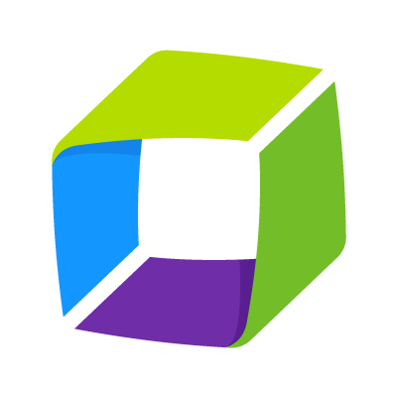
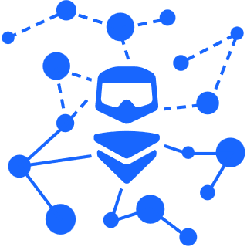
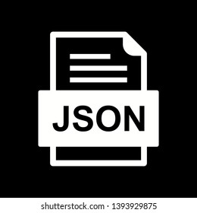
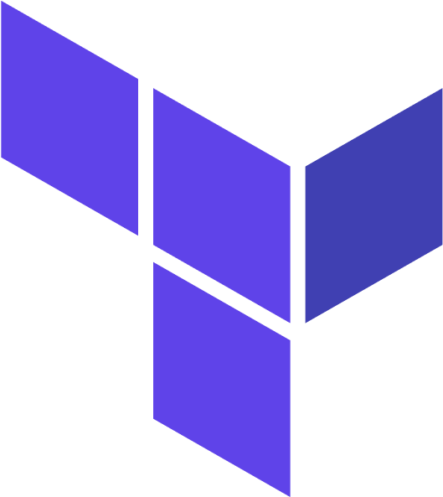
Dynatrace as part of your Modernization Journey
Move to the Cloud
Containerized Applications
Move-to-Serverless
Build with Cloud-Native
Microservices-based
Serverless architecture
DevOps model
Azure VM
Azure Service Fabric
Container Instances
Azure Kubernetes Instances
Azure Functions
Azure API Management
Azure App Services
Applications
Azure Functions
Azure Storage Account
Azure
Cosmos DB
Customer operates everything above the infrastructure
Azure API Management
Azure Kubernetes Service
On-Prem ➤ Cloud Native
VMs ➤ Containers
Purpose-Built
Build New
Notes:
Dynatrace and Azure are purpose built to drive your modernization journey
As you being to move workloads to the cloud
As you begin to leverage cloud best practices
Cloud native services
Azure’s platform form offerings will meet your needs
Dynatrace will help you ensure that they are performing
***

Slide 14
What the hack environment setup

Slide 15
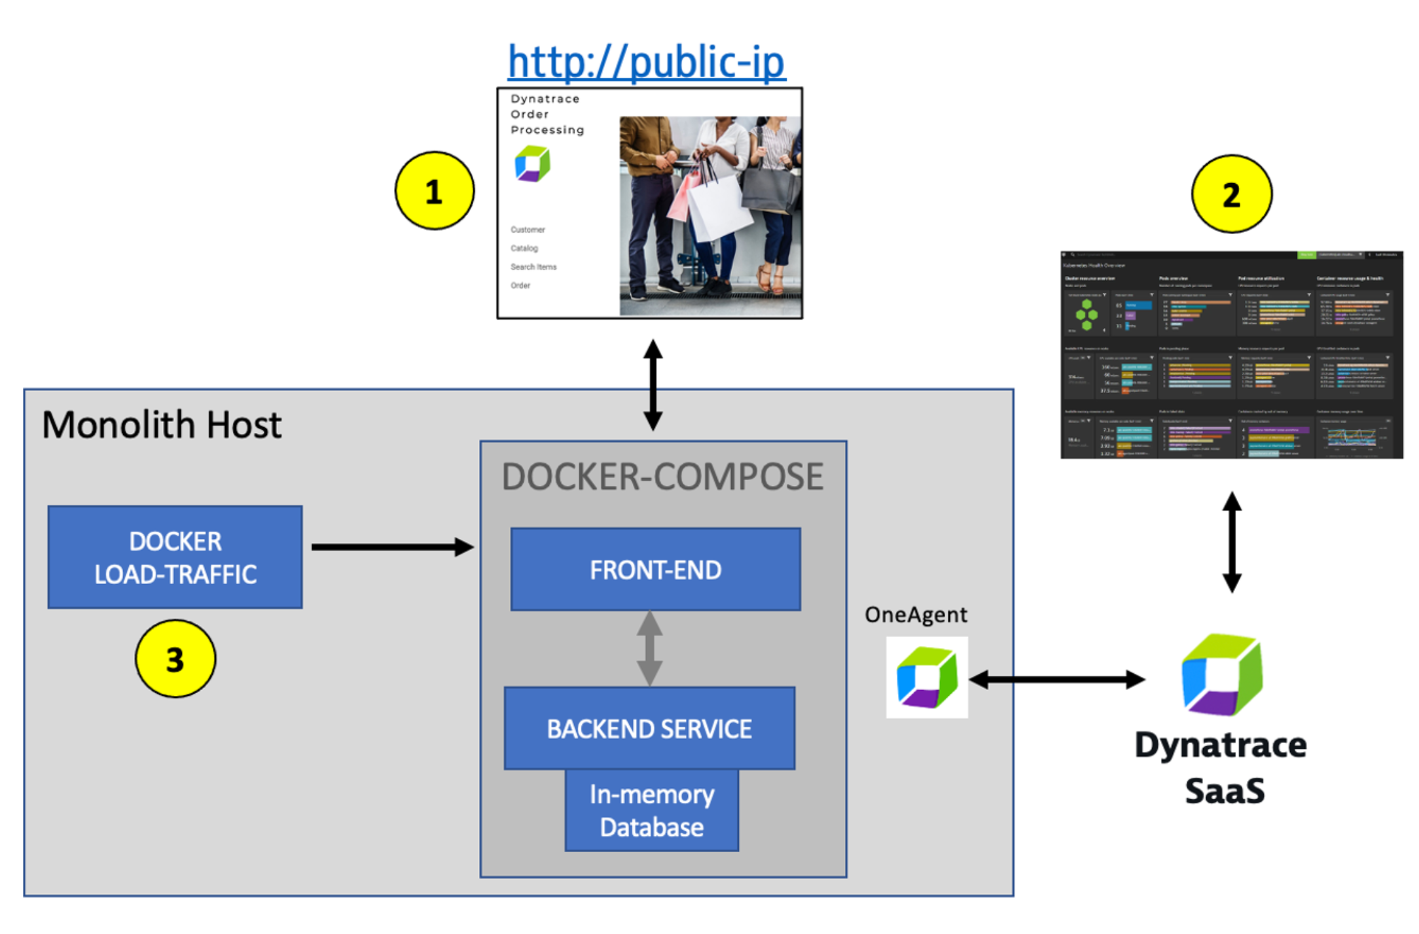
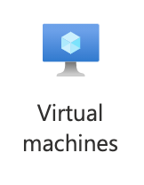

Workshop Environment for Monolith VM

Slide 16
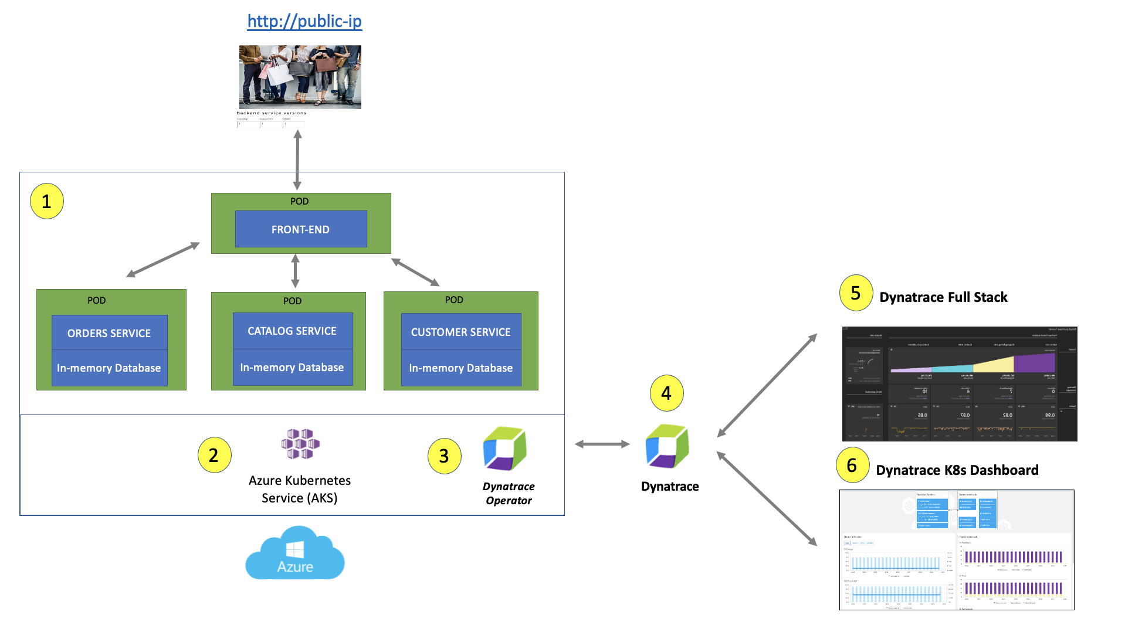
Workshop Environment for AKS

Slide 17
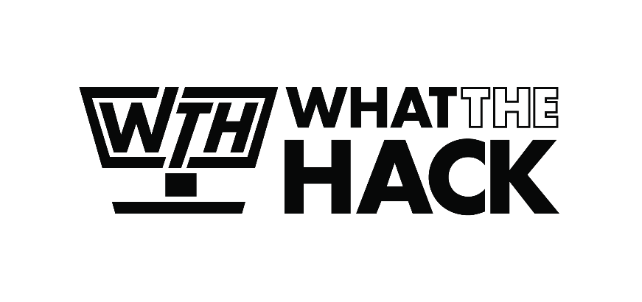
Challenge Zero Get your machines ready!
Sign up for Azure Free Trial Account
Sign-up for free of Azure Native Dynatrace Service via Marketplace
If not using Azure Cloud, please
Install the Azure CLI (in WSL if on Windows!)
Notes:
Modify this slide and add the pre-reqs specific to your hack here.
Each challenge slide should list the key goals for the challenge.

Slide 18

Challenge 1 - Dynatrace Observability on Azure VM
Notes:
For each “mini-lecture”, have a topic title and/or sub-topic title.
Each mini-lecture should be no longer than 5-10 minutes in length.
Only deliver one lecture ahead of each challenge.
Do not attempt to present all of the lectures before students start hacking.

Slide 19
Challenge #1 Dynatrace Observability on Azure VM
Review Dynatrace OneAgent data
Review data on host view
Review SmartScape view
Review Service Flow view
Review Service Back trace view
Review Database view
Review Technologies view
Review real-time data available for the sample application
Pull up a distributed trace and perform a multi-dimensional analysis
Review how Dynatrace helps with modernization planning
Notes:
For each challenge, list out the key high-level goals.
If there are important specifications, list them here, or remind students to “read the student guide!”

Slide 20
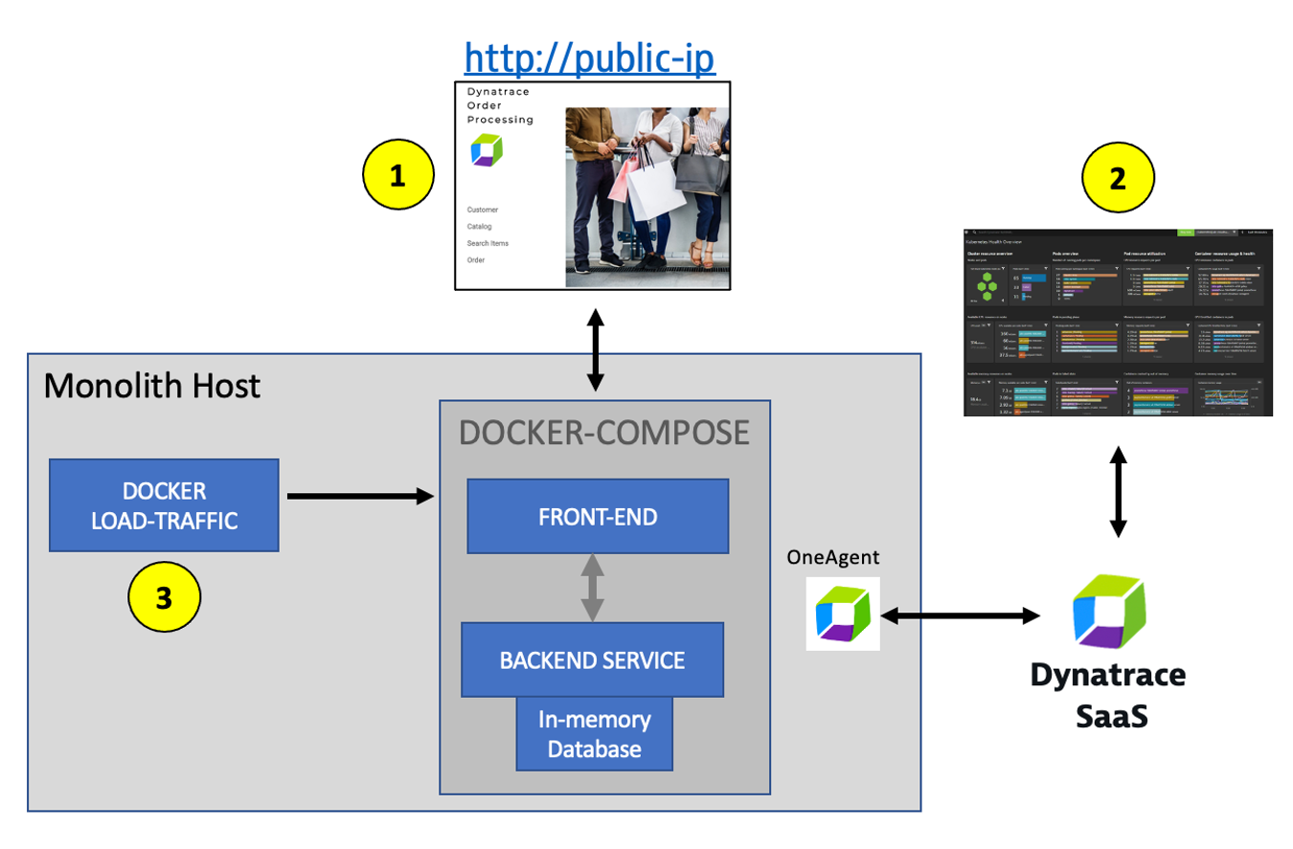
Dynatrace Observability on Azure VM
Notes:
Template for a lecture slide with bullets (if you need them).
Try to NOT use bullet lists in your presentation.
Diagrams, puppy pictures, etc are always better. ☺ ---notes---- * While choosing the right migration strategies, such as re-hosting or re-architecting, one must assess the different risks, costs, and benefits. However, often the details of what is where and what is dependent on what within the technical stack is missing or poorly documented. All that may exist is out of date diagrams and a mix of monitoring tool metrics that must be "stitched" together.
* Not having enough details about the current environment is hindering organizations ability to make the right decisions when planning what to migrate and when.
* To address this problem, Dynatrace’s OneAgent can automatically discover the application, services, processes and to build a complete dependency mapping for the entire application environment. So, let’s begin!

Slide 21
Challenge 2 – Dynatrace Observability on AKS
Notes:
For each “mini-lecture”, have a topic title and/or sub-topic title.
Each mini-lecture should be no longer than 5-10 minutes in length.
Only deliver one lecture ahead of each challenge.
Do not attempt to present all of the lectures before students start hacking.

Slide 22
Challenge #2 Dynatrace Observability on AKS
Deploy the Dynatrace Operator for Kubernetes
Deploy the sample application on Kubernetes
Analyze sample application on Kubernetes
Notes:
For each challenge, list out the key high-level goals.
If there are important specifications, list them here, or remind students to “read the student guide!”

Slide 23
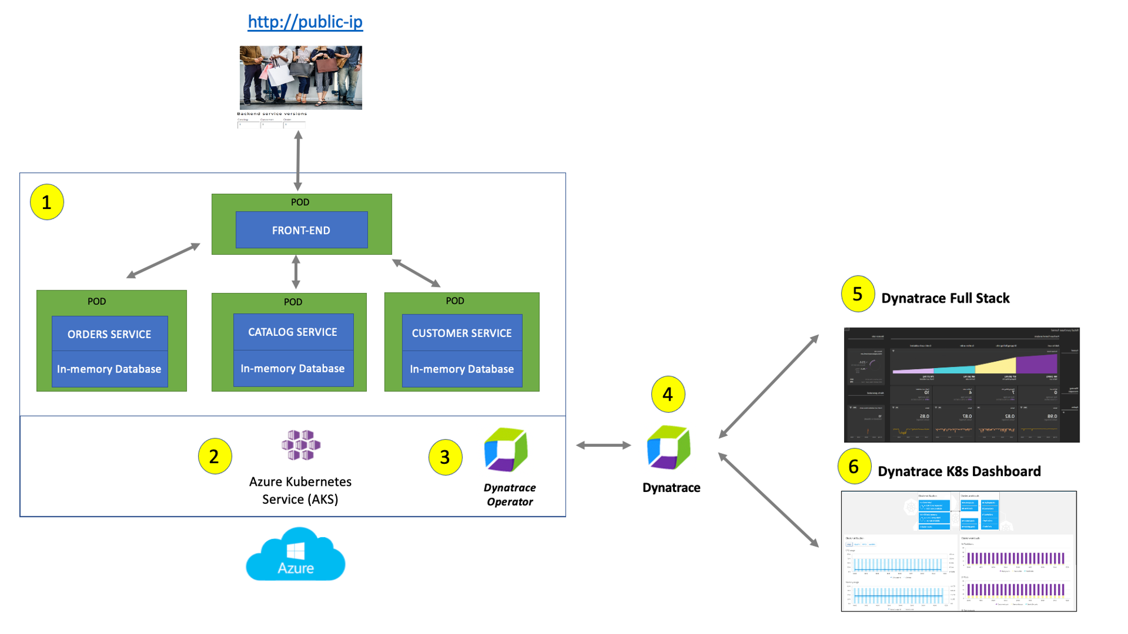
Dynatrace Observability on AKS
Notes:
Template for a lecture slide with bullets (if you need them).
Try to NOT use bullet lists in your presentation.
Diagrams, puppy pictures, etc are always better. ☺

Slide 24
Challenge 3 - Automated Root Cause Analysis with Davis®️
Notes:
For each “mini-lecture”, have a topic title and/or sub-topic title.
Each mini-lecture should be no longer than 5-10 minutes in length.
Only deliver one lecture ahead of each challenge.
Do not attempt to present all of the lectures before students start hacking.

Slide 25
Challenge 3 Automated Root Cause Analysis with Davis®️
Enable a problem pattern in same application on monolith
Review what Dynatrace Davis®️ AI found as root cause to the issue on VM
Enable a problem pattern on sample application on AKS
Review what Dynatrace Davis®️ AI found as root cause to the issue on AKS
Notes:
For each challenge, list out the key high-level goals.
If there are important specifications, list them here, or remind students to “read the student guide!”

Slide 26
Challenge 4 – Azure Monitor Metrics & Custom Dashboard
Notes:
For each “mini-lecture”, have a topic title and/or sub-topic title.
Each mini-lecture should be no longer than 5-10 minutes in length.
Only deliver one lecture ahead of each challenge.
Do not attempt to present all of the lectures before students start hacking.

Slide 27
Challenge 4 Azure Monitor Metrics & Custom Dashboards
Review how Dynatrace integrates with Azure monitor
Review how Azure monitor metrics can be configured as Metric events for alerts
Create a custom dashboard with SLOs
Examine Dynatrace Service Level Objectives (SLOs)
Notes:
For each challenge, list out the key high-level goals.
If there are important specifications, list them here, or remind students to “read the student guide!”

Slide 28
Challenge 5 – Grail Dashboards & Notebooks
Notes:
For each “mini-lecture”, have a topic title and/or sub-topic title.
Each mini-lecture should be no longer than 5-10 minutes in length.
Only deliver one lecture ahead of each challenge.
Do not attempt to present all of the lectures before students start hacking.

Slide 29
Challenge 5 Grail Dashboards & Notebooks
Query, Visualize and observe data stored in Grail with Dashboards & Notebooks
Analyze log and metric data with Notebooks
Utilize multiple visualization techniques in notebooks.
Notes:
For each challenge, list out the key high-level goals.
If there are important specifications, list them here, or remind students to “read the student guide!”

Slide 30
Challenge 6 – Site Reliability Guardians & Workflows
Notes:
For each “mini-lecture”, have a topic title and/or sub-topic title.
Each mini-lecture should be no longer than 5-10 minutes in length.
Only deliver one lecture ahead of each challenge.
Do not attempt to present all of the lectures before students start hacking.

Slide 31
Challenge 6 Grail Site Reliability Guardians & Workflows
Learn about the benefits of Site Reliability Guardians (SRG)
Implement an SRG to measure reliability.
Experience the power of Dynatrace Automation with Workflows
Setup a workflow to execute an SRG on a scheduled time interval.
Notes:
For each challenge, list out the key high-level goals.
If there are important specifications, list them here, or remind students to “read the student guide!”

Slide 32
Challenge 7 – Cleanup
Notes:
For each “mini-lecture”, have a topic title and/or sub-topic title.
Each mini-lecture should be no longer than 5-10 minutes in length.
Only deliver one lecture ahead of each challenge.
Do not attempt to present all of the lectures before students start hacking.

Slide 33
Challenge 7 Cleanup
Cleanup your environment if you’re all done!
Notes:
For each challenge, list out the key high-level goals.
If there are important specifications, list them here, or remind students to “read the student guide!”

Slide 34

Thank You for Attending! https://aka.ms/wth
Notes:
Thank students for attending and share the link to the What The Hack website with them.

